Slide 1
4.9 Instruction Processing
31
The fetch-decode-execute cycle is the series of steps that a computer carries out when it runs a program.
We first have to fetch an instruction from memory, and place it into the IR.
Once in the IR, it is decoded to determine what needs to be done next.
If a memory value (operand) is involved in the operation, it is retrieved and placed into the MBR.
With everything in place, the instruction is executed.
The next slide shows a flowchart of this process.

Slide 2
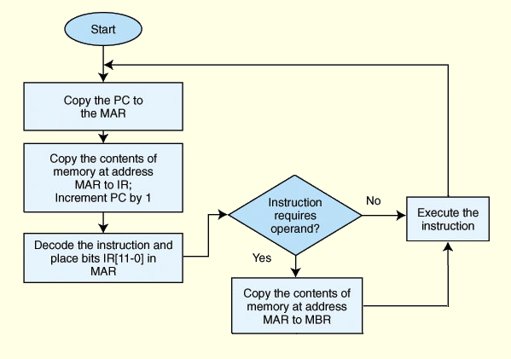
4.9 Instruction Processing
32

Slide 3
4.9 Instruction Processing
32b
The fetch-decode-execute cycle is sometimes called the fetch-decode-fetch-execute cycle.
That’s because after you decode an instruction, you may have to fetch data from one or memory addresses, depending on the format of the instruction.

Slide 4
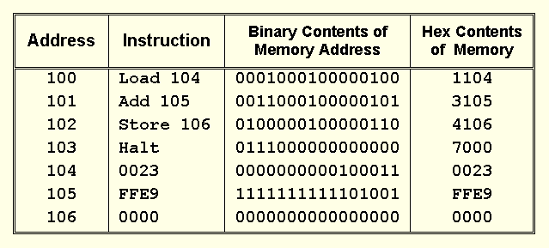
4.10 A Simple Program
38
Consider the simple MARIE program given below. We show a set of mnemonic instructions stored at addresses 100 - 106 (hex):
Subt

Slide 5
4.10 A Simple Program
38
Explanation of chart on preceding slide:
  First column: address of that line of program
  Second column: instruction in words
  Third column: instruction encoded in binary
  Fourth column: instruction encoded in hex
Things to notice
  First nibble of instruction is op code; the rest is address
  Op code is 4 bits, so fits in one nibble
  Address is 12 bits, so needs 3 nibbles
  The data in 104 - 106 isn’t important; program will work with any data. Data for Marie is in 2’s complement form.

Slide 6
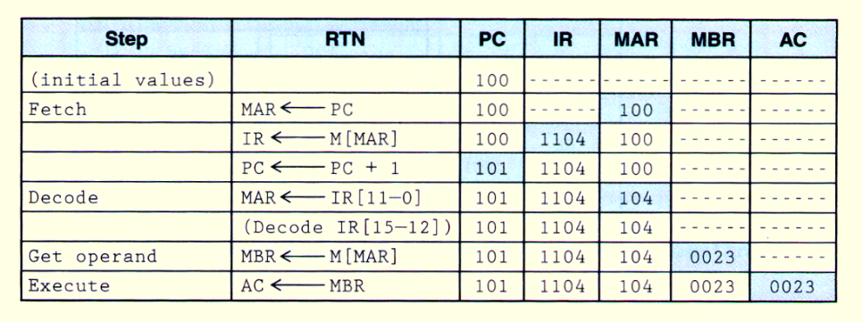
4.10 A Simple Program
39
Let’s look at what happens inside the computer when our program runs. This is the LOAD 104 instruction.
For each line, make sure you understand what happens in each column. Changes are highlighted in blue.

Slide 7
4.10 A Simple Program
39b
RTN = register transfer notation, a synonym for RTL.
The RTN on each line tells you which register is updated and where the new value comes from.

Slide 8
4.10 A Simple Program
39c
The line in parentheses means that the RTN “branches” according to which instruction was decoded.
That line needs no RTN because it uses combinational logic.
That instruction will be executed in the execute step. Here it is the ‘load’ instruction.

Slide 9
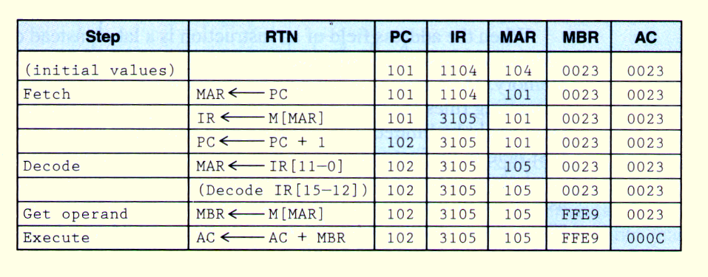
4.10 A Simple Program
40
Our second instruction is ADD 105.
The fetch, decode and “get operand” (i.e., fetch the data) steps are the same.

Slide 10
4.10 A Simple Program
40b
The only thing that is different is the execute, since the instruction is ‘add’ instead of ‘load’.
The AC now has the value of AC + MBR. Remember that MARIE has 2’s complement addition.

